Slide 1

DATA Preprocessing
Talha Ubaid

Slide 2
Data preprocessing
Data preprocessing is a technique which is used to transform the raw data in a useful and efficient format.
So many different forms: Structured Tables, Images, Audio files, Videos etc..
In any Machine Learning process, Data Preprocessing is that step in which the data gets transformed, or Encoded, to bring it to such a state that now the machine can easily parse it.
In other words, the features of the data can now be easily interpreted by the algorithm

Slide 3
Why need to preprocessing
Most of the real world data is raw.
The data we collected from different resources such as internet, self collection and organization needs to preprocessed.
There may be problems in the dataset due to
human error
limitations of measuring devices
flaws in the data collection process etc.

Slide 4
Issues with the dataset
Missing values
Inconsistent values
Duplicate values etc.
We need to remove these kinds of things

Slide 5
Missing values
If you dataset have missing values you have to complete your data.
How to Handle missing values?
Case1: remove the missing values
Case 2: add the values by assumption. Not a good approach
Case 3: add the other class “unknown”
Case 4: Use the “mean” of all data and add it.

Slide 6
Example (Missing values)
Name | Age | Gender | Predicted class(sports liked)
Umar | 24 | M | Cricket
Ali | ? | M | Football
Ayesha | 16 | F | Cricket
Zeeshan | 18 | ? | Cricket
Awais | 22 | M | Football
Zara | 14 | F | ?
Saad | ? | M | Cricket
Amna | 19 | ? | Cricket
Sadia | 21 | F | Football
Safora | ? | F | Cricket
Saif | 20 | M | Cricket

Slide 7
Example (Missing values-add by self assumption)
Name | Age | Gender | Predicted class(sports liked)
Umar | 24 | M | Cricket
Ali |  | M | Football
Ayesha | 16 | F | Cricket
Zeeshan | 18 | ? | Cricket
Awais | 22 | M | Football
Zara | 14 | F
Saad |  | M | Cricket
Amna | 19 | ? | Cricket
Sadia | 21 | F | Football
Safora |  | F | Cricket
Saif | 20 | M | Cricket

Slide 8
Example (Missing values-add by self assumption)
Name | Age | Gender | Predicted class(sports liked)
Umar | 24 | M | Cricket
Ali |  | M | Football
Ayesha | 16 | F | Cricket
Zeeshan | 18 | M | Cricket
Awais | 22 | M | Football
Zara | 14 | F
Saad |  | M | Cricket
Amna | 19 | F | Cricket
Sadia | 21 | F | Football
Safora |  | F | Cricket
Saif | 20 | M | Cricket

Slide 9
Example (Missing values-add by “Unknown class”)
Name | Age | Gender | Predicted class(sports liked)
Umar | 24 | M | Cricket
Ali |  | M | Football
Ayesha | 16 | F | Cricket
Zeeshan | 18 | M | Cricket
Awais | 22 | M | Football
Zara | 14 | F | ?
Saad |  | M | Cricket
Amna | 19 | F | Cricket
Sadia | 21 | F | Football
Safora |  | F | Cricket
Saif | 20 | M | Cricket

Slide 10
Example (Missing values-add by “Unknown class”)
Name | Age | Gender | Predicted class(sports liked)
Umar | 24 | M | Cricket
Ali |  | M | Football
Ayesha | 16 | F | Cricket
Zeeshan | 18 | M | Cricket
Awais | 22 | M | Football
Zara | 14 | F | Unknown
Saad |  | M | Cricket
Amna | 19 | F | Cricket
Sadia | 21 | F | Football
Safora |  | F | Cricket
Saif | 20 | M | Cricket

Slide 11
Example (Missing values-add by “Mean values”)
Name | Age | Gender | Predicted class(sports liked)
Umar | 24 | M | Cricket
Ali | ? | M | Football
Ayesha | 16 | F | Cricket
Zeeshan | 18 | M | Cricket
Awais | 22 | M | Football
Zara | 14 | F | Unknown
Saad | ? | M | Cricket
Amna | 19 | F | Cricket
Sadia | 21 | F | Football
Safora |  | F | Cricket
Saif | 20 | M | Cricket

Slide 12
Example (Missing values-add by “Mean values”)
Name | Age | Gender | Predicted class(sports liked)
Umar | 24 | M | Cricket
Ali | 22 (Mean) | M | Football
Ayesha | 16 | F | Cricket
Zeeshan | 18 | M | Cricket
Awais | 22 | M | Football
Zara | 14 | F | Unknown
Saad | 22 (Mean) | M | Cricket
Amna | 19 | F | Cricket
Sadia | 21 | F | Football
Safora |  | F | Cricket
Saif | 20 | M | Cricket

Slide 13
Convert Categorical Data to Numerical Data
Data often contain label values rather than numeric values.
Machine learning models algorithm required numerical data.
To over come this we have 2 methods
Integer Encoding
One-Hot Encoding

Slide 14
Integer Encoding
Each unique category value is assigned an
integer value.
Example person weight i.e. Over Weight,
Normal, and Under Weight.
Person | Health | Integer Encoding
Ali | Over Weight
Raza | Under Weight
Sana | Normal
Mughees | Over Weight
Alina | Normal
Hamza | Under Weight

Slide 15
Integer Encoding
Each unique category value is assigned an
integer value.
Example person weight i.e. Over Weight is 1,
Normal is 2, and Under Weight is 3.
Person | Health | Integer Encoding
Ali | Over Weight | 1
Raza | Under Weight | 3
Sana | Normal | 2
Mughees | Over Weight | 1
Alina | Normal | 2
Hamza | Under Weight | 3

Slide 16
Integer Encoding
Example, “Red” is 1, “Pink” is 2, and “Blue” is 3.
In this example no such ordinal relationship exists,
the integer encoding is not enough.
In fact, using this encoding and allowing the model to
assume a natural ordering between categories may
result in poor performance or unexpected results
(predictions halfway between categories).
Person | Fav Color | Integer Encoding
Ali | Red | 1
Raza | Blue | 3
Sana | Pink | 2
Mughees | Red | 1
Alina | Pink | 2
Hamza | Blue | 3

Slide 17
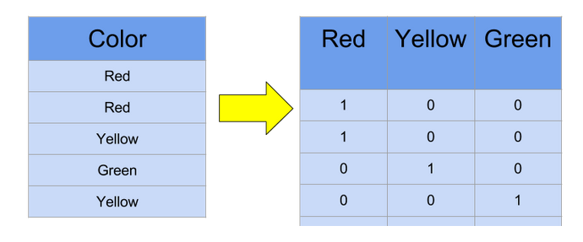
One-Hot Encoding
One hot encoding creates new (binary) columns, indicating the presence of each possible value from the original data. Let's work through an example

Slide 18
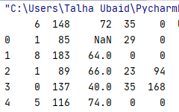
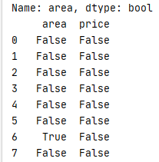
To view the missing values in your dataset
If you dataset has empty/ null columns. It will show “nan” in that cell when you print.(using .head())
To checking the missing values : (using .isnull())
Here true values means null/empty values in there at that location.

Slide 19

To count the null values in data
Use the .isnull().sum()
Here “area” and price are the column and in area there is only 1 missing values whilw in price we have no missing values.

Slide 20
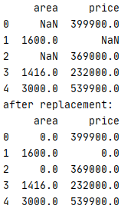
Replacing with values any values with “NaN”
To replace 0 with nan.
.replace(nan,0)
Here you can replace “nan” with any number or vice versa
you can replace with any number.

Slide 21
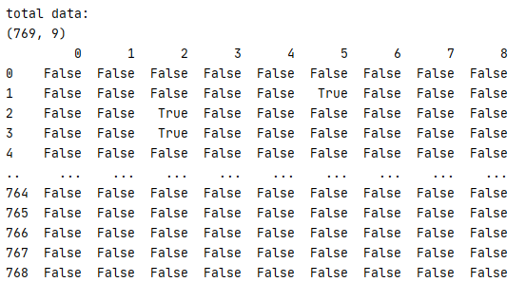

To remove row that has missing values
.dropna (inplace=true)

Slide 22
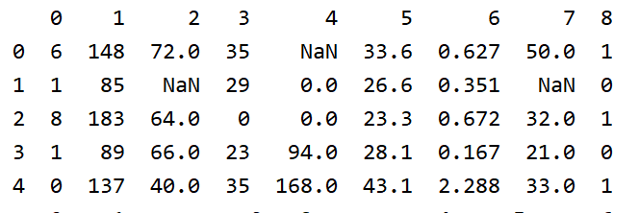
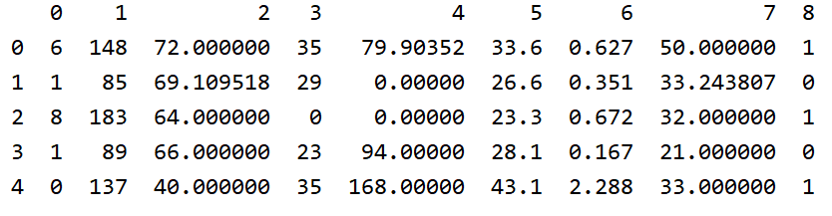
To input missing values
Multiples methods can be used such as mean, mode
.fillna(dataset.mean(),inplace=true)

